Slide 1
SLEEPING DISORDERS AND POSTURES DURING WORK
Health and Lifestyle
Class - 12

Slide 2
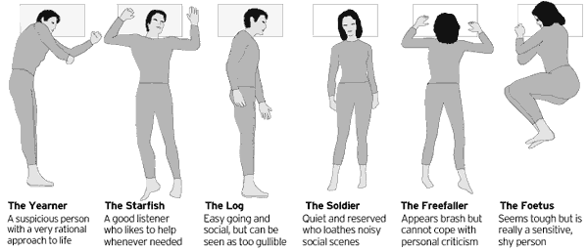
SLEEPING POSTURES

Slide 3
RESTING PATTERN AND POSTURES
Sleep or rest is a behavioral state that is a natural part of every individual’s life.
We spend about one-third of our lives asleep. Sleep is a required activity, not an option. Sleep is important for normal motor and cognitive function.
Problem sleepiness is associated with difficulty concentrating, memory lapses, loss of energy, fatigue, lethargy, and emotional instability.
The prevalence of problem sleepiness has serious consequences, such as drowsy driving or workplace accidents and errors.
Lifestyle factors and undiagnosed or untreated sleep disorders can cause problem sleepiness.
Lifestyle factors include not getting enough sleep, having an irregular sleep schedule, and using alcohol or certain medications, electronic usage at nights, waking late nights.

Slide 4
Of the more than 70 known sleep disorders, the most common are obstructive sleep apnea, insomnia, narcolepsy, and restless legs syndrome.
Approximately 100,000 automobile crashes each year result from young male drivers who were “asleep at the wheel.”
Alcohol does not promote good sleep, and consuming alcohol in the evening can also exacerbate sleep apnea problems.
Environmental noise, temperature changes, changes in sleeping surroundings, and other factors may affect our ability to get sufficient restful sleep.

Slide 5
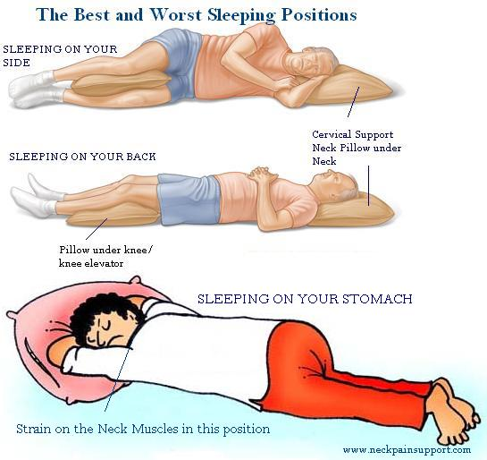
BEST AND WORST SLEEPING POSTURES
Each one of us would like to know how to sleep well so that we get up well-rested. A number of factors are involved in how to sleep well. One of the factors is our sleep posture. We all have a typical sleep posture and we feel comfortable when we sleep in that sleep posture.
On Your Back, Arms at Sides
On Your Back, Arms Up
Face Down
Fetal Position
On Side, Arms at Sides
On Side, Arms Out
On the Right Side
Pillow-Supplemented

Slide 6
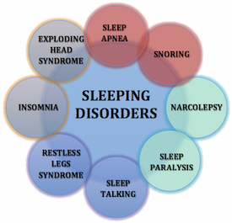
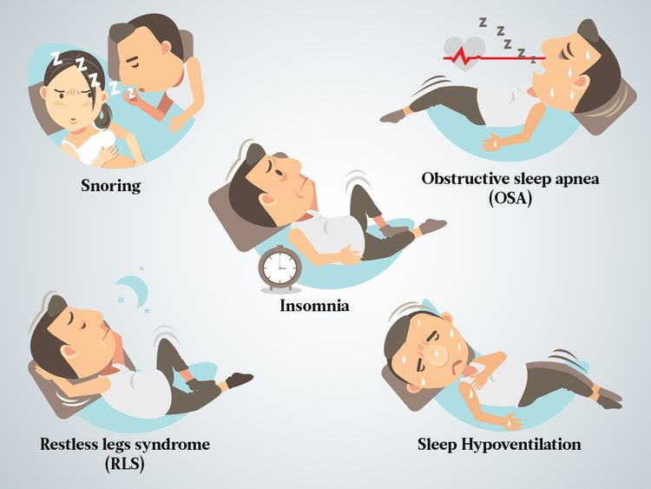
SLEEP DISORDERS

Slide 7
SLEEP DISORDERS
Insomnia is a sleep disorder in which you have trouble falling and/or staying asleep. The condition can be short-term (acute) or can last a long time (chronic). It may also come and go. Acute insomnia lasts from 1 night to a few weeks. Insomnia is chronic when it happens at least 3 nights a week for 3 months or more
Obstructive sleep apnea (OSA) is a potentially life-threatening disorder in which breathing is interrupted during sleep.
Restless legs syndrome (RLS) is a neurologic movement disorder that is often associated with a sleep complaint. People with RLS have unpleasant leg sensations and an almost irresistible urge to move the legs.
Narcolepsy is a chronic sleep disorder that usually becomes evident during adolescence or young adulthood and can affect both men and women. The main characteristic of narcolepsy is excessive and overwhelming daytime sleepiness (even after adequate nighttime sleep) at inappropriate times and places.
Parasomnias are sleep disorders that involve sleepwalking, sleep talking, enuresis (bed-wetting), and sleep terrors, which are NREM disorders that occur early in the night.

Slide 8
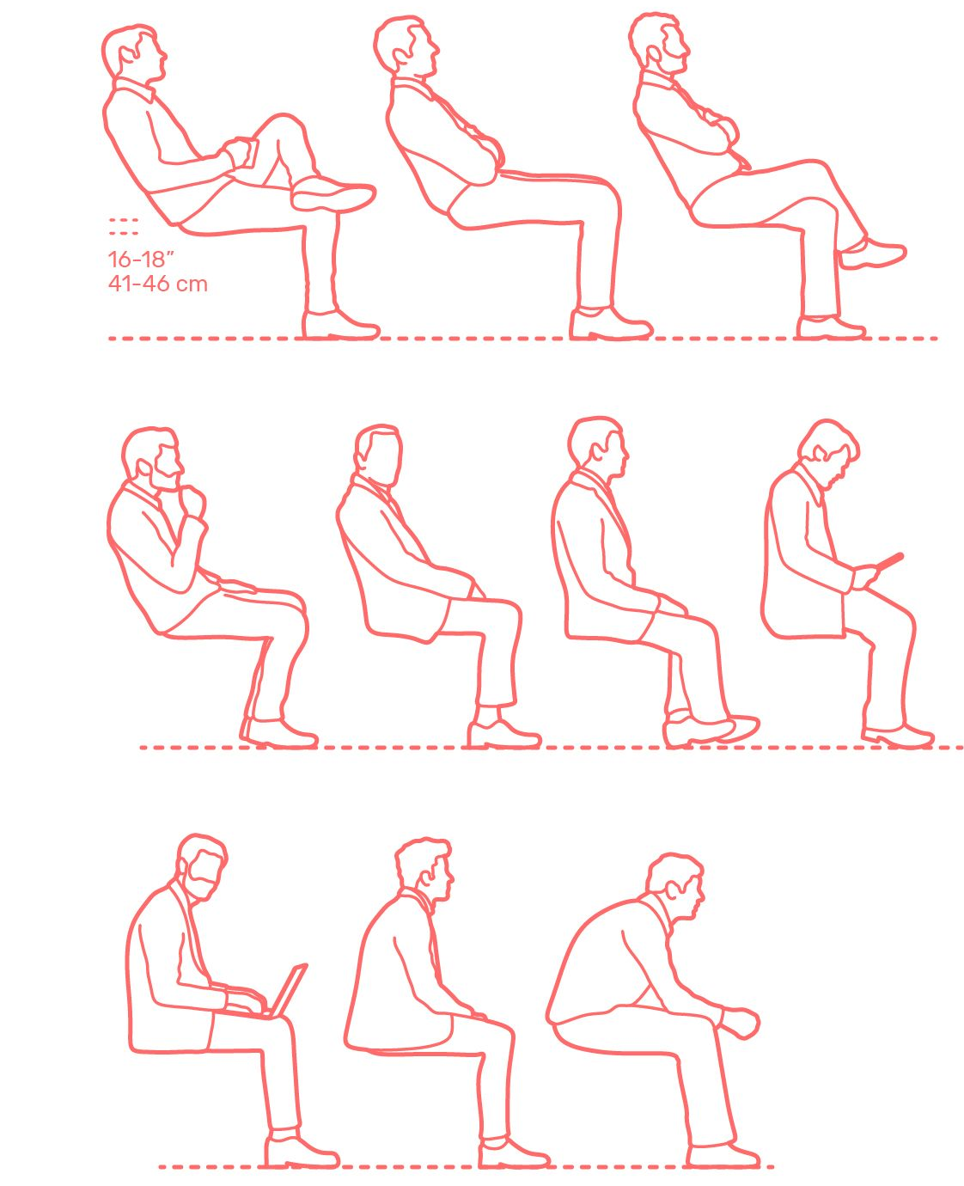
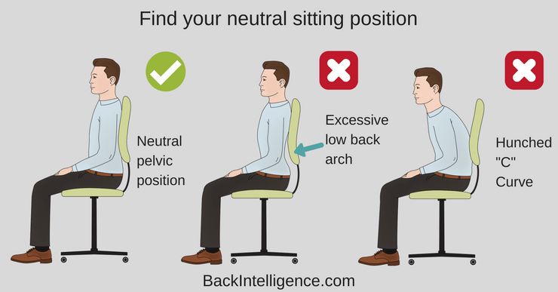
POSTURES IN OFFICE

Slide 9
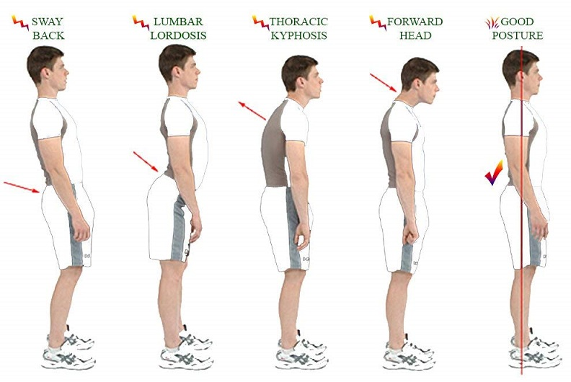
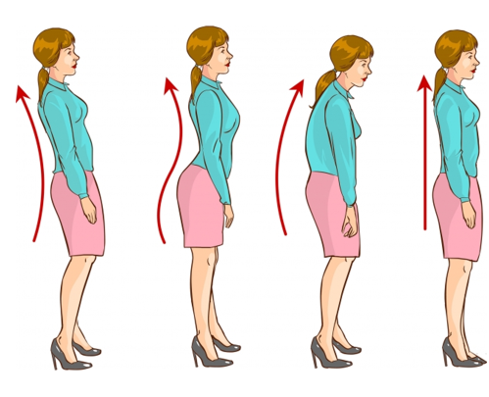
WRONG POSTURES WHILE STANDING

Slide 10
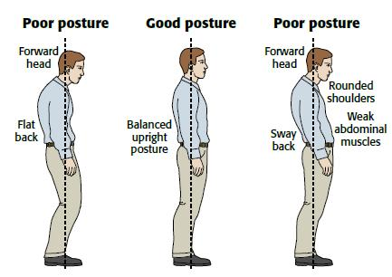
GOOD POSTURE WHILE STANDING

Slide 11
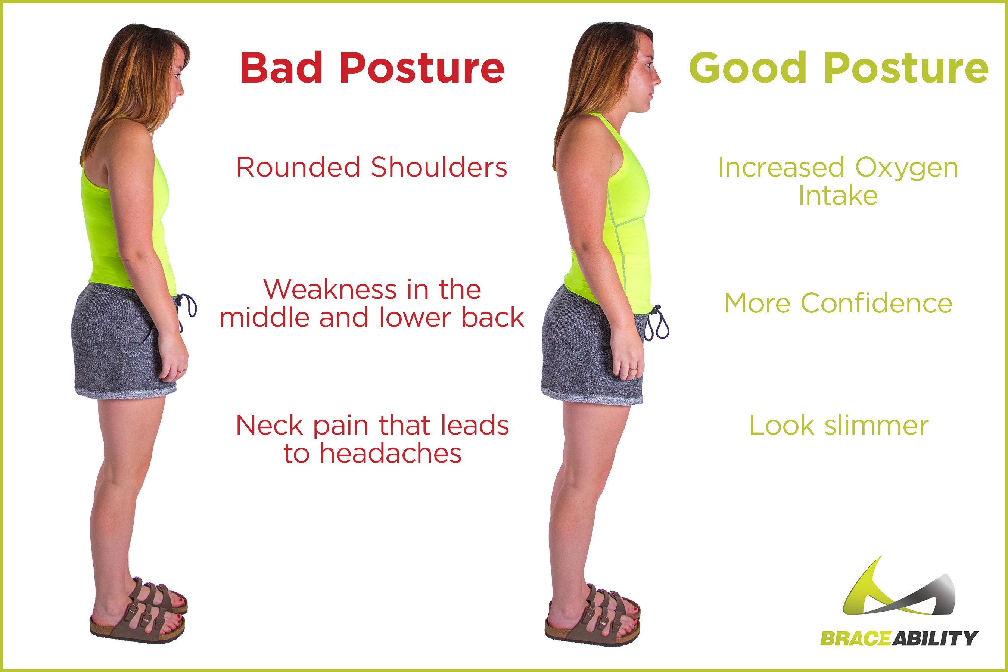

Slide 12
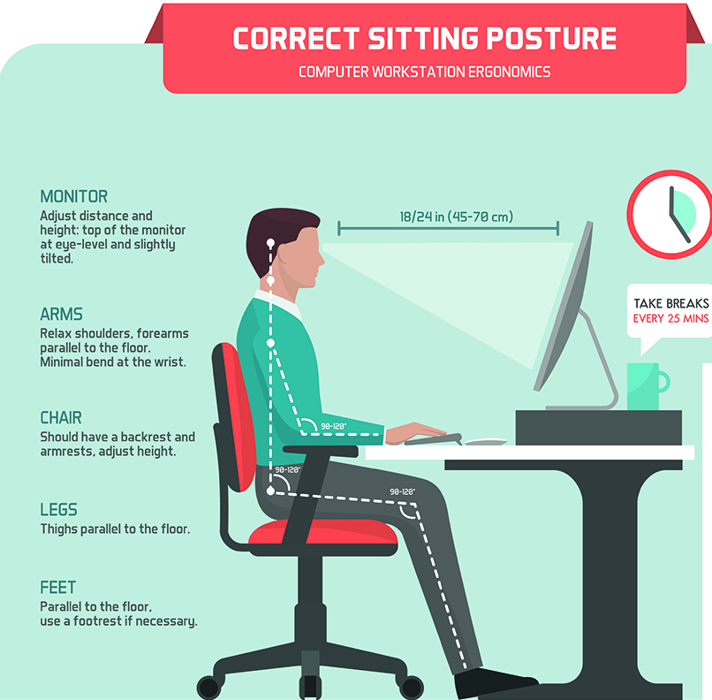
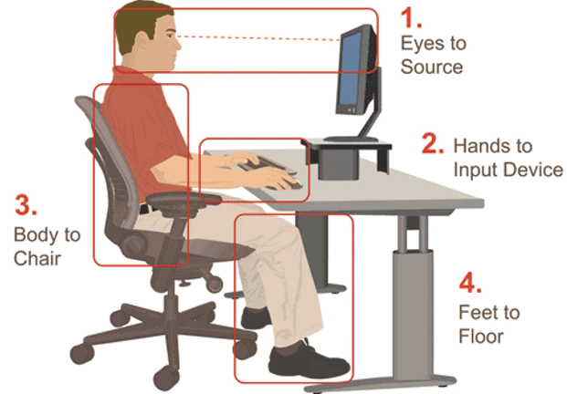
BETTER OFFICE ERGONOMICS

